Slide 1
Introduction to PHP
NAME : TWINKLE CHAVHAN
DATE : 13/11/2024

Slide 2
What is PHP ?
PHP stands for “PHP: Hypertext Preprocessor” (recursive acronym).
It was originally created by Danish-Canadian programmer Rasmus Lerdorf in 1993 and released in 1995.
PHP is a popular server-side scripting language used in Web development to create dynamic web pages and applications.
PHP scripts run on the server. The results are then sent to the client’s web browser as plain HTML.
PHP file extension is .php

Slide 3
Example of PHP
Syntax : PHP code starts and ends with these tags.
<?php
// PHP code goes here
?php>
<?php
echo “Hello World!!”
?php>
OUTPUT : Hello World!!

Slide 4
PHP can do ..
PHP can generate dynamic web content.
PHP can create, read, write, open, close files on web servers.
PHP can add, modify and delete data from database.
PHP can restrict user to access some pages on your website.
PHP can encrypt data.

Slide 5
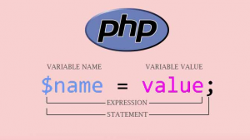
Variables in PHP
Variables are containers for storing information and data that can be accessed within your code
Starts from $ symbol and for declared a variable we have to assign a value to it.
Case-sensitive means, $name and $Name are the different variables.
Must begin with a letter or an underscore(_), not numbers.

Slide 6
Example of Variables :
Example 1 :
<?php
$firstName = “Vidhi”; //valid
$_age = 25; //valid
$2ndName = “Riya”; //invalid
$class = “physics”; //invalid
?>
Example 2 :
<?php
$name = “Parag”;
$salary = 40000;
Echo “This guy is $name and his income is Rs. $salary.”
?>
OUTPUT : This guy is Parag and his income is Rs. 40000.

Slide 7
Thank you

